Slide 1



RFM Customer Segmentation & Cohort Analysis
By: G-1 Team
Noura Alajmi
Hibah Sindi
Shahad Ali
Reema Almeshal
Ammar Alhawashem
Maram Alzahrani
Sara
Taif Alzahr
Noof Alsafi
Raya

Slide 2
Outlines:
Project Overview
Data Cleaning & Exploratory Data Analysis
RFM Analysis
Customer Segmentation
Applying Clustering
Create Cohort and Conduct Cohort Analysis
Conclusion

Slide 3
Project Overview

Slide 4
Problem Statement
In the retail industry, it is crucial for businesses to comprehend the value obtained from each customer.

Slide 5
Goal
The aim of this project is to analyze the online retail dataset, understand customer behavior, do costumer segmentation in order to derive actionable insights for effective business strategies.

Slide 6
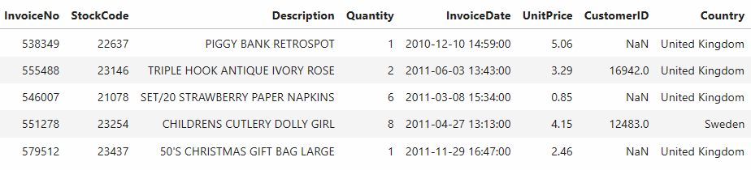
Dataset
This is a transnational data set between 01/12/2010 and 09/12/2011 for a UK-based and registered non-store online retail.
It consists of 8 columns & more than 541000 rows.

Slide 7
Data Cleaning &
Exploratory Data Analysis
2
Notes:
where it can classify new images based on their textual descriptions without the need for explicit training on specific image classes.

Slide 8
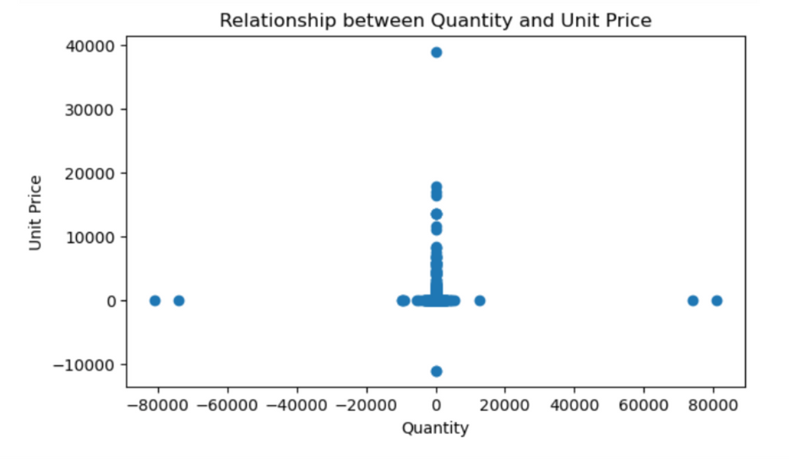
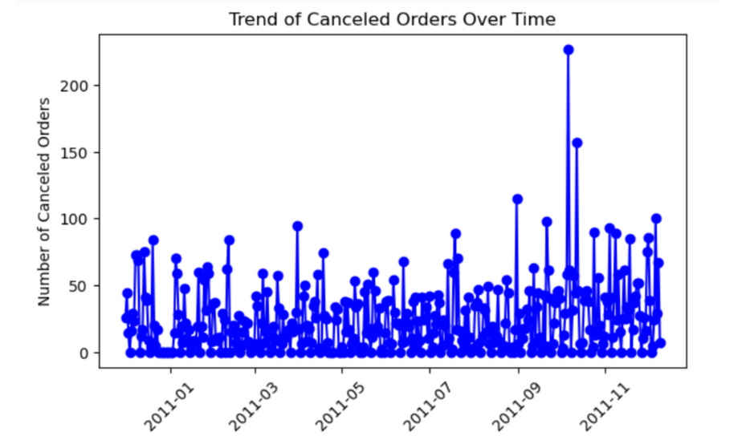
Data Cleaning & EDA
Dealing with noisy data:
Missing Values
0 values
Duplicated
Typos

Slide 9
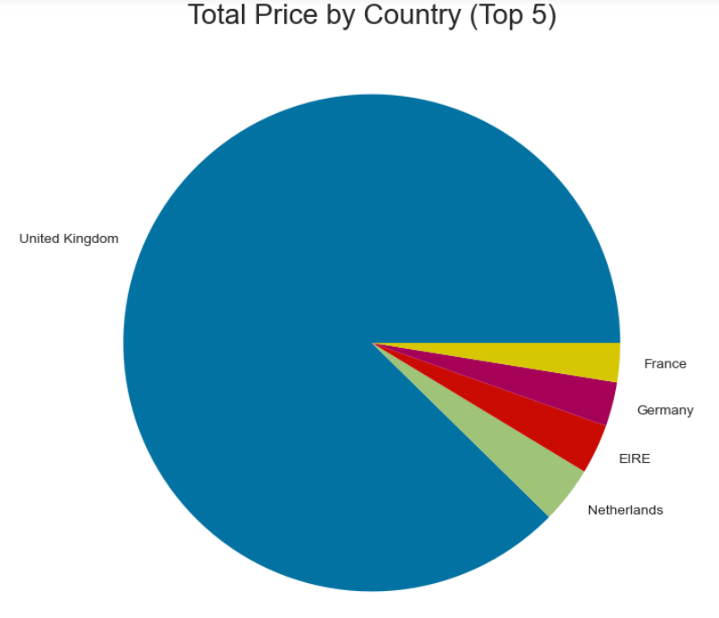
Exploring Customers by Country

Slide 10
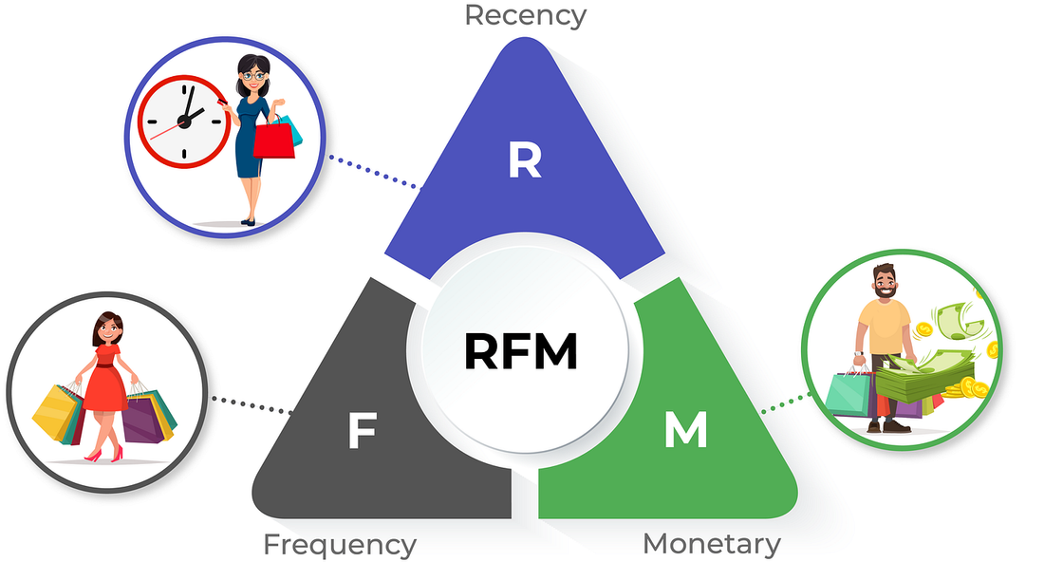
RFM Analysis

Slide 11
What RFM means?
RECENCY: Time since last purchase.
FREQUENCY: Total number of purchases.
MONETARY VALUE: Total monetary value.

Slide 12
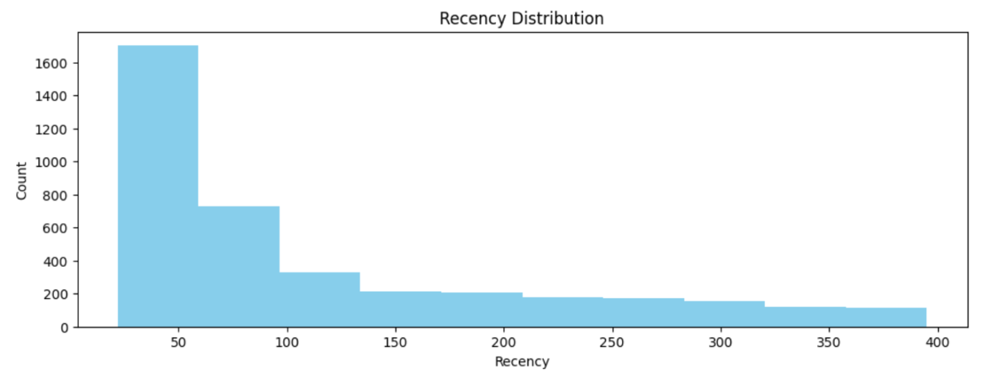
For each customer we calculated the number of days since the customer's last purchase by choosing the last day in the year as a point of reference.

Slide 13
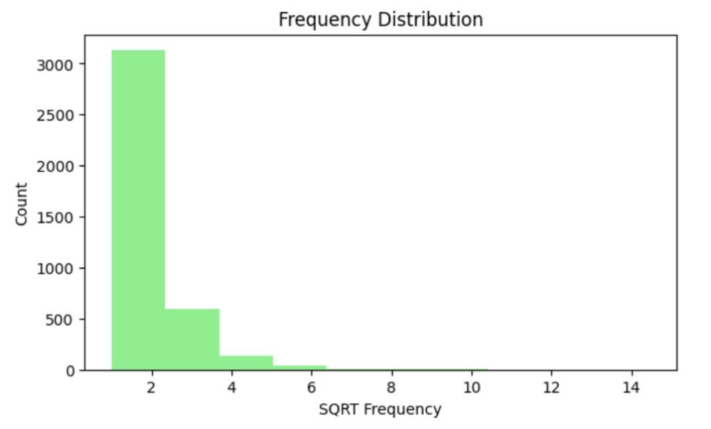
For each customer we calculated the total number of purchases, by counting the total number of invoices related to each customer.

Slide 14
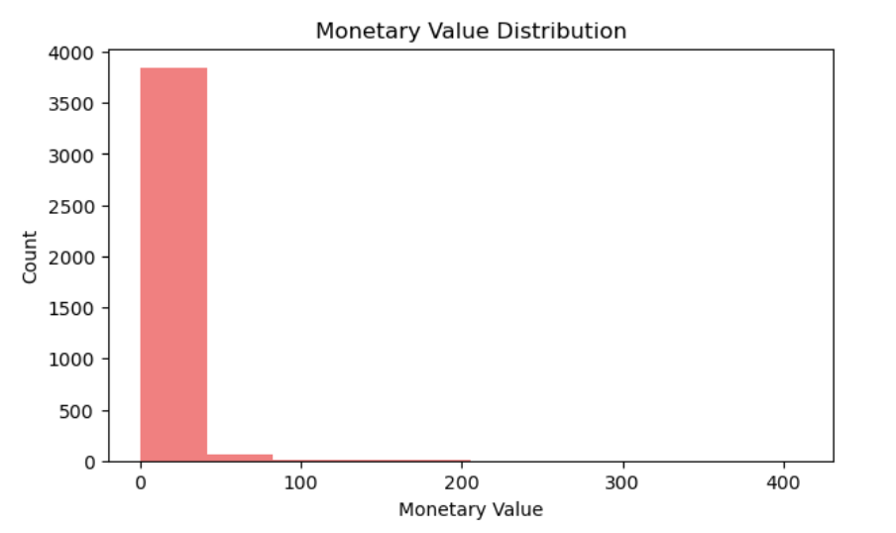
For each customer, we calculated the total amount of money spent by adding together the total price for each item the customer was purchased.

Slide 15
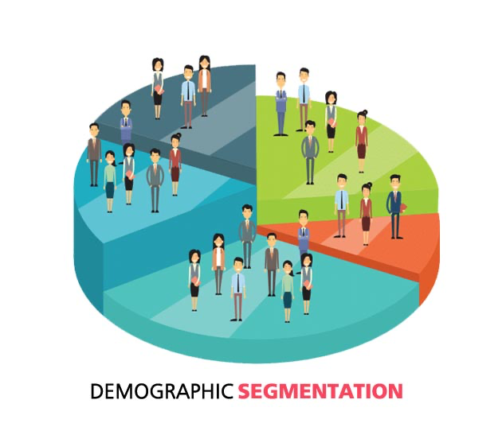
Customer Segmentation

Slide 16
What Customers Segmentation means?
Segmentation is a marketing term that refers to aggregating prospective buyers into groups or segments with common needs and who respond similarly to a marketing action.
In our case we could segment customers according to their precise needs.

Slide 17
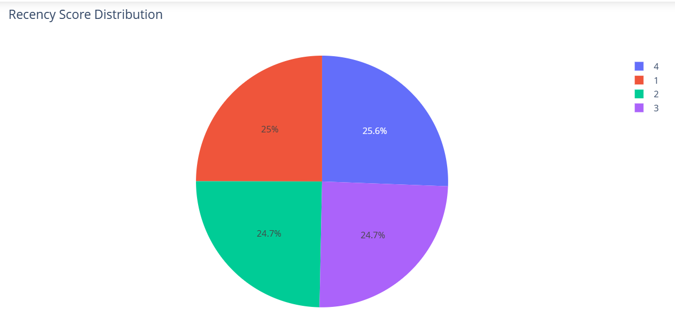
Recency Score Distribution

Slide 18
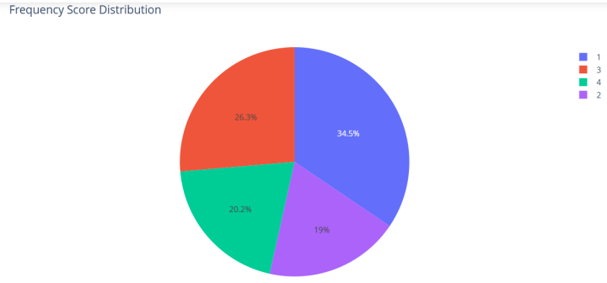
Frequency Score Distribution

Slide 19
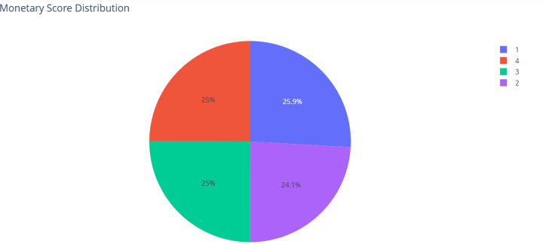
Monetary Score Distribution

Slide 20
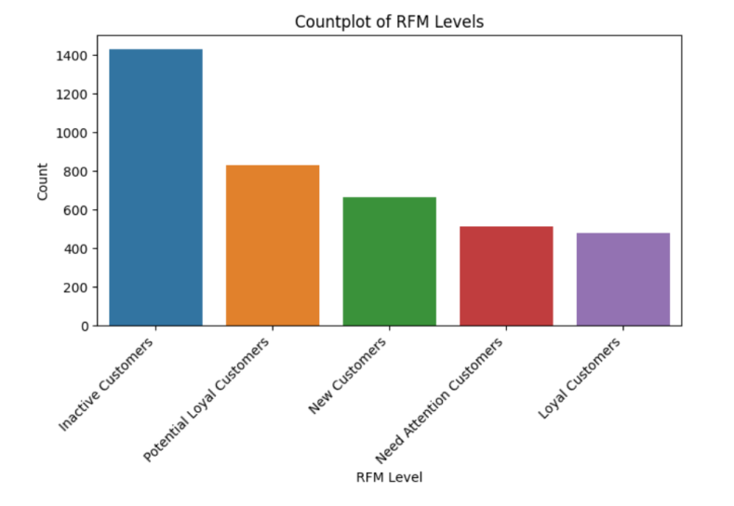
RFM Segments plot

Slide 21
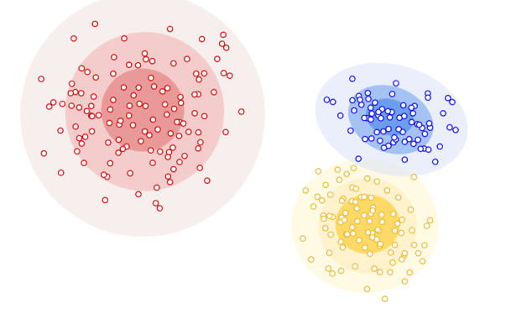
Applying Clustering

Slide 22
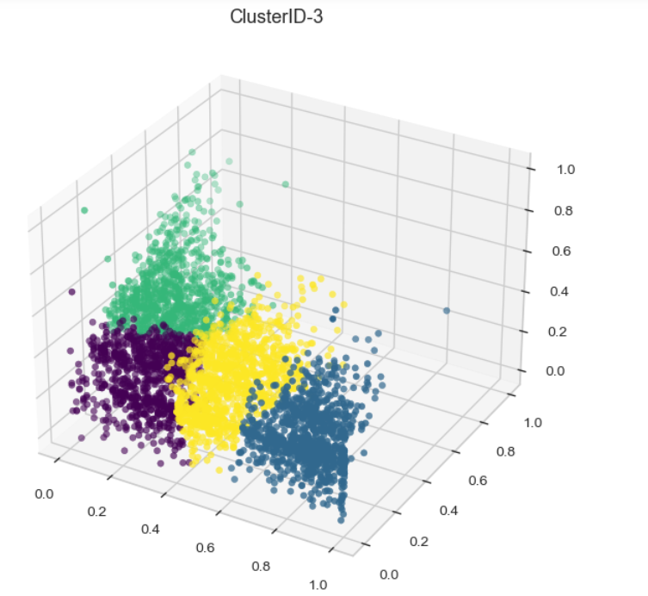
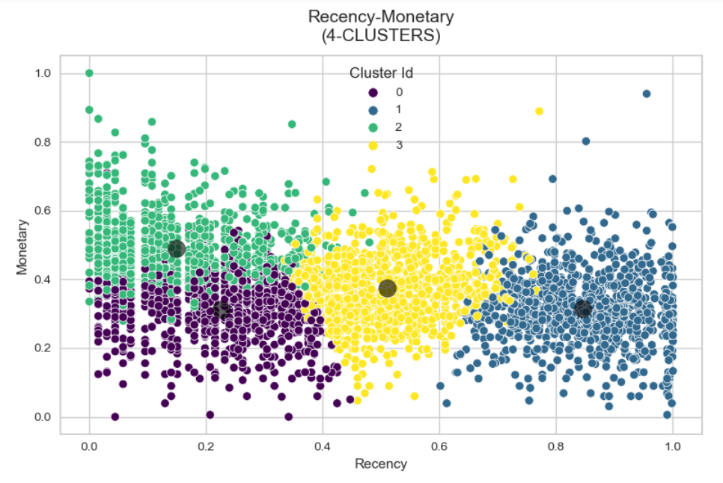
Clustering Implementation

Slide 23
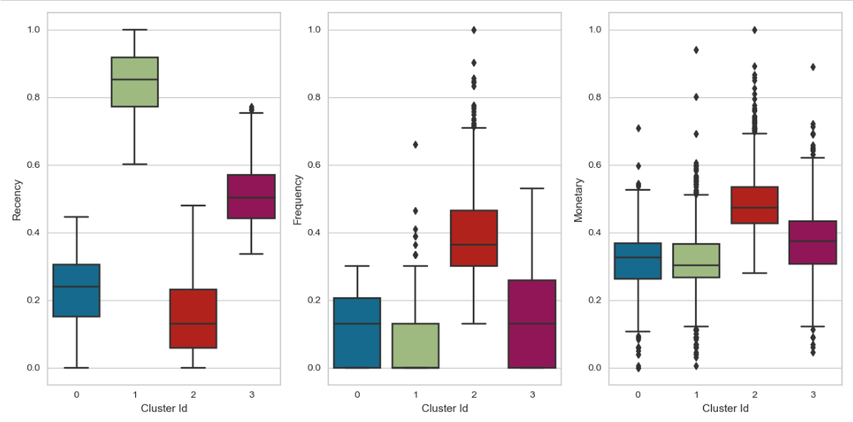
Results
Inactive Customers
Potential Loyal Customers
Seasonal Cutomers
Inactive Customers
Potential Loyal Customers
Seasonal Cutomers
Inactive Customers
Potential Loyal Customers
Seasonal Cutomers
New Customers
New Customers
New Customers

Slide 24
Create Cohort and Conduct Cohort Analysis
Notes:
In Linear Algebra, one common way to measure if two vectors are of similar characteristics (they are like each other) is to calculate their dot product (multiplying the matching entries and take the sum of them); if the final number is big, they are alike and if it is small they are not (relatively speaking)!

Slide 25
What’s Cohort Analysis?
Cohort analysis is a tool that groups customers into “cohorts” based on shared characteristics, especially the time they started using a product.
Why we use Cohort Analysis?
We use cohort analysis for tracking and analyzing the behavior of groups of users over time.
Notes:
In Linear Algebra, one common way to measure if two vectors are of similar characteristics (they are like each other) is to calculate their dot product (multiplying the matching entries and take the sum of them); if the final number is big, they are alike and if it is small they are not (relatively speaking)!

Slide 26
We will conduct Cohort Analysis by creating three cohorts, which are:
1st Cohort: User number & Retention Rate
2nd Cohort: Average Quantity Sold
3rd Cohort: Average Sales
Notes:
In Linear Algebra, one common way to measure if two vectors are of similar characteristics (they are like each other) is to calculate their dot product (multiplying the matching entries and take the sum of them); if the final number is big, they are alike and if it is small they are not (relatively speaking)!

Slide 27
In order to create the three cohrots, we need to do the following steps:
Month Extraction from InvioceDate column
Assigning Cohort to Each Transaction
Assigning Cohort Index to each transaction
Notes:
In Linear Algebra, one common way to measure if two vectors are of similar characteristics (they are like each other) is to calculate their dot product (multiplying the matching entries and take the sum of them); if the final number is big, they are alike and if it is small they are not (relatively speaking)!

Slide 28
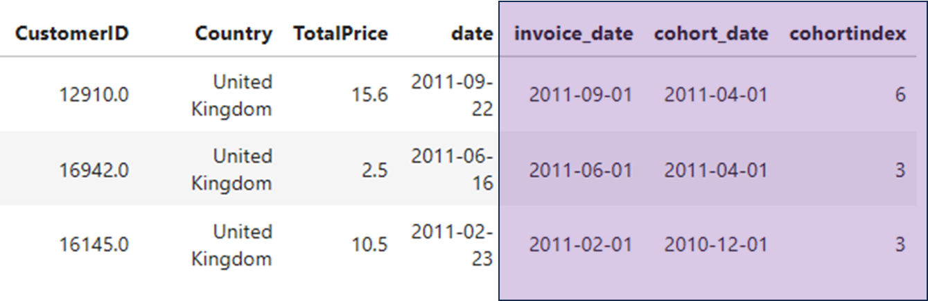
Dataset after applying the steps :
Notes:
In Linear Algebra, one common way to measure if two vectors are of similar characteristics (they are like each other) is to calculate their dot product (multiplying the matching entries and take the sum of them); if the final number is big, they are alike and if it is small they are not (relatively speaking)!

Slide 29
1st Cohort:
User number & Retention Rate
Retention Rate:
The retention rate gives you the percentage of active customers compared to the total number of customers
Therefore we will count how many customers per each cohort date & cohort index.
Notes:
In Linear Algebra, one common way to measure if two vectors are of similar characteristics (they are like each other) is to calculate their dot product (multiplying the matching entries and take the sum of them); if the final number is big, they are alike and if it is small they are not (relatively speaking)!

Slide 30
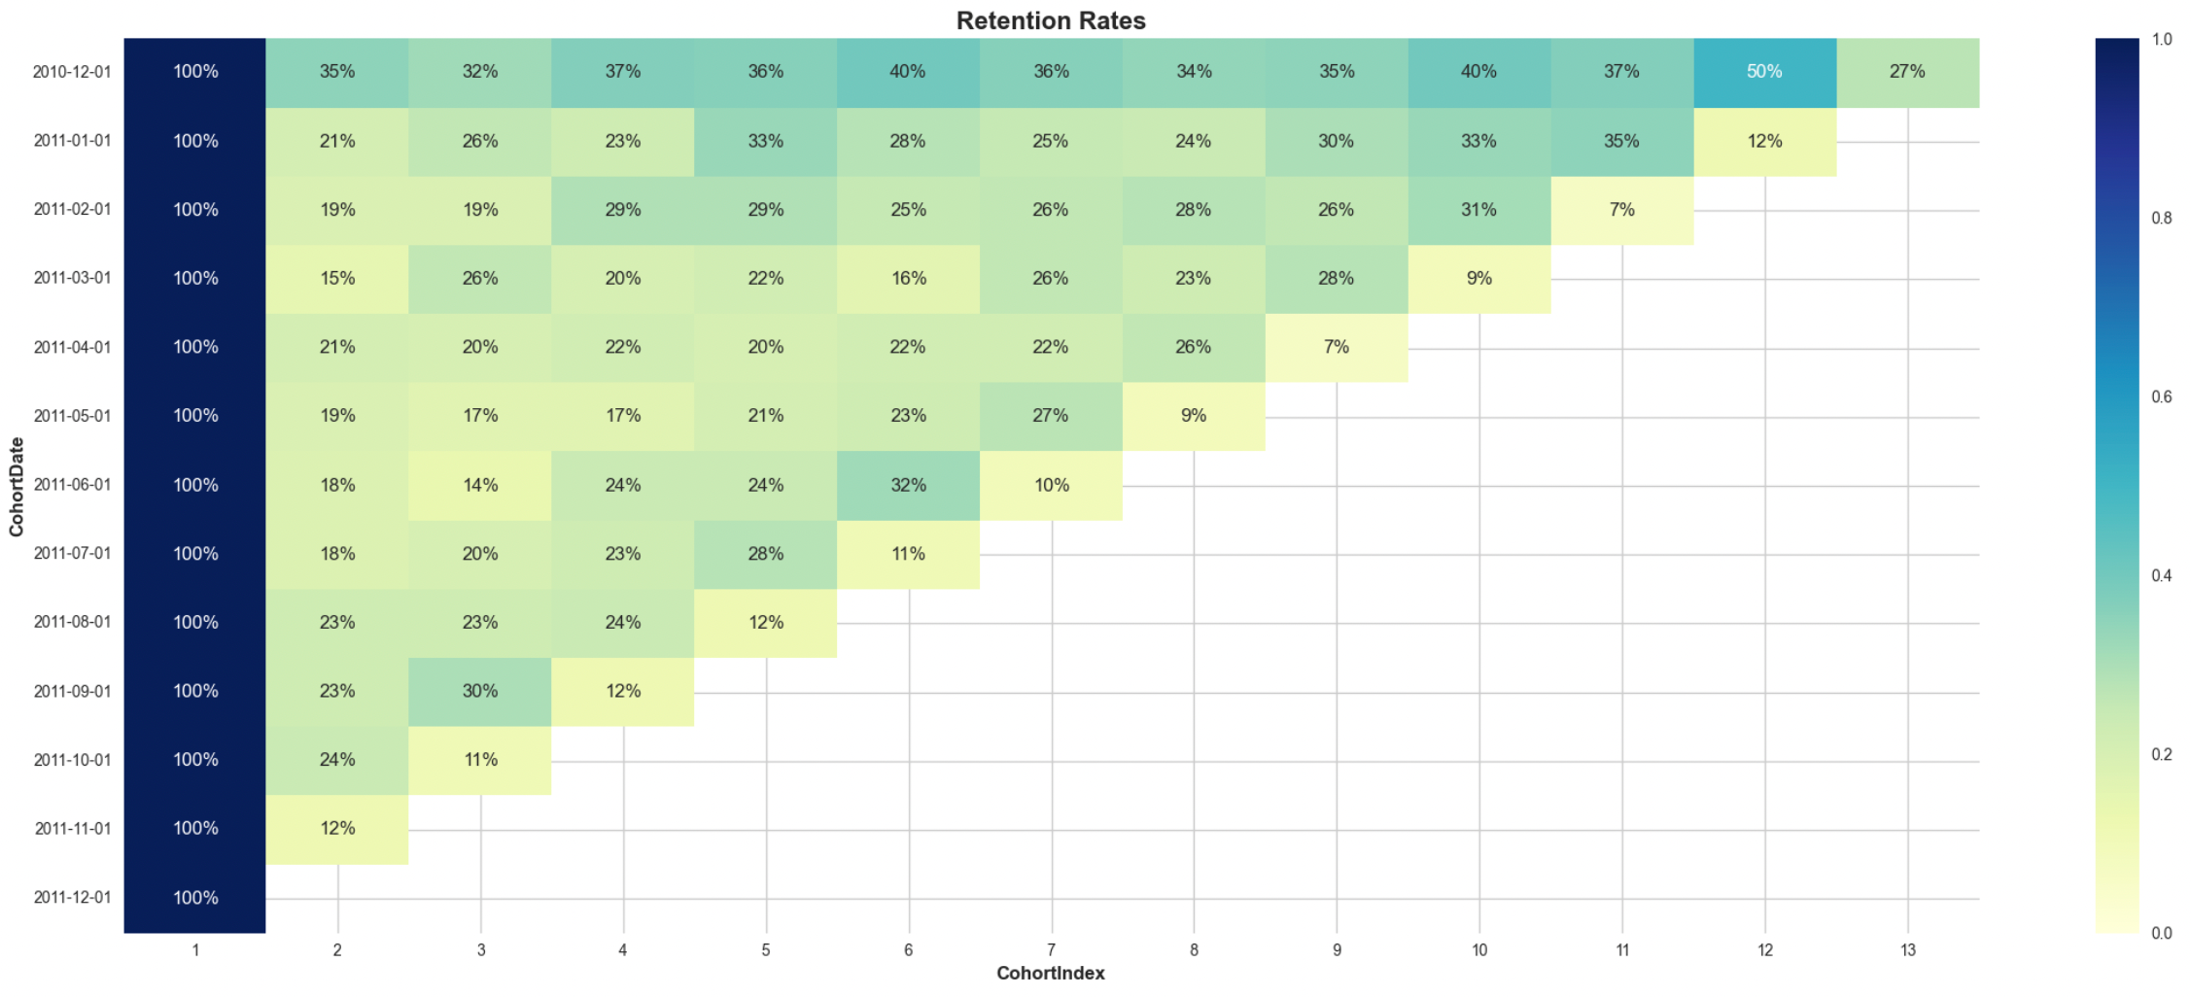
1st Cohort: User number & Retention Rate
Notes:
In Linear Algebra, one common way to measure if two vectors are of similar characteristics (they are like each other) is to calculate their dot product (multiplying the matching entries and take the sum of them); if the final number is big, they are alike and if it is small they are not (relatively speaking)!

Slide 31
2nd Cohort: Average Quantity Sold
Average Quantity Sold:
We will calculate the average quantity sold per each cohort date & cohort index.
Notes:
In Linear Algebra, one common way to measure if two vectors are of similar characteristics (they are like each other) is to calculate their dot product (multiplying the matching entries and take the sum of them); if the final number is big, they are alike and if it is small they are not (relatively speaking)!

Slide 32
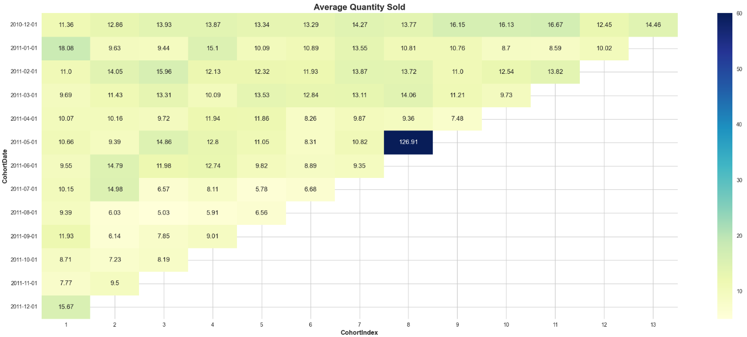
2nd Cohort: Average Quantity Sold
Notes:
In Linear Algebra, one common way to measure if two vectors are of similar characteristics (they are like each other) is to calculate their dot product (multiplying the matching entries and take the sum of them); if the final number is big, they are alike and if it is small they are not (relatively speaking)!

Slide 33
3rd Cohort: Average Sales
Average Sales
We will calculate the average Total Price per each cohort date & cohort index.
Notes:
In Linear Algebra, one common way to measure if two vectors are of similar characteristics (they are like each other) is to calculate their dot product (multiplying the matching entries and take the sum of them); if the final number is big, they are alike and if it is small they are not (relatively speaking)!

Slide 34
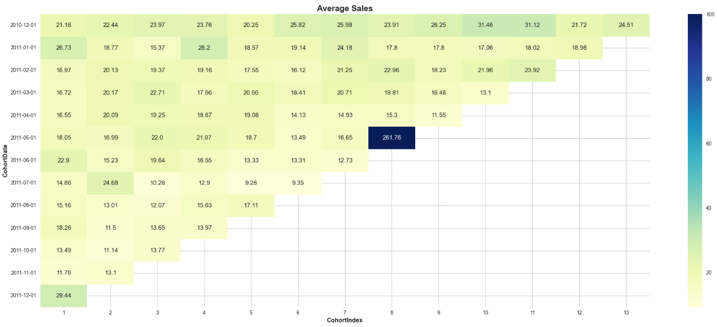
3rd Cohort: Average Sales
Notes:
In Linear Algebra, one common way to measure if two vectors are of similar characteristics (they are like each other) is to calculate their dot product (multiplying the matching entries and take the sum of them); if the final number is big, they are alike and if it is small they are not (relatively speaking)!

Slide 35
Cohort Analysis Results
Notes:
In Linear Algebra, one common way to measure if two vectors are of similar characteristics (they are like each other) is to calculate their dot product (multiplying the matching entries and take the sum of them); if the final number is big, they are alike and if it is small they are not (relatively speaking)!

Slide 36
The cohorts analysis hows that people tend to buy more during the end-of-year season. If businesses communicate well and build relationships, customers who shop during specific seasons might become regular buyers. It's not just about getting new customers; keeping the ones you already have is just as important.
Notes:
In Linear Algebra, one common way to measure if two vectors are of similar characteristics (they are like each other) is to calculate their dot product (multiplying the matching entries and take the sum of them); if the final number is big, they are alike and if it is small they are not (relatively speaking)!

Slide 37
Conclusion
Notes:
In Linear Algebra, one common way to measure if two vectors are of similar characteristics (they are like each other) is to calculate their dot product (multiplying the matching entries and take the sum of them); if the final number is big, they are alike and if it is small they are not (relatively speaking)!

Slide 38
The project investigated customer behavior using RFM analysis, K-means clustering, and cohorts analysis. We found that the outcomes of K-means and RFM segmentation are similar.
The acquired insights offer practical strategies for focused marketing and enhanced customer engagement.
Notes:
In Linear Algebra, one common way to measure if two vectors are of similar characteristics (they are like each other) is to calculate their dot product (multiplying the matching entries and take the sum of them); if the final number is big, they are alike and if it is small they are not (relatively speaking)!

Slide 39
Thanks for Listening

